Slide 1





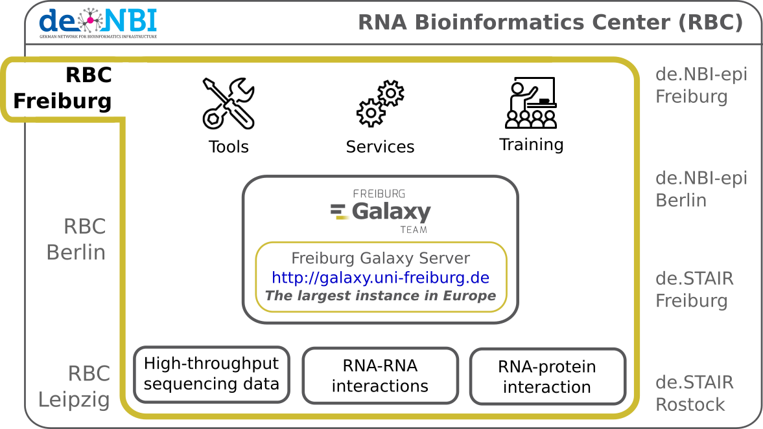

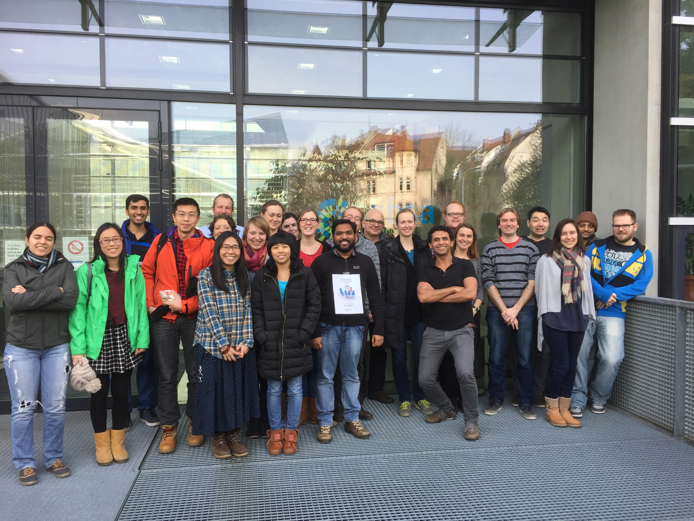
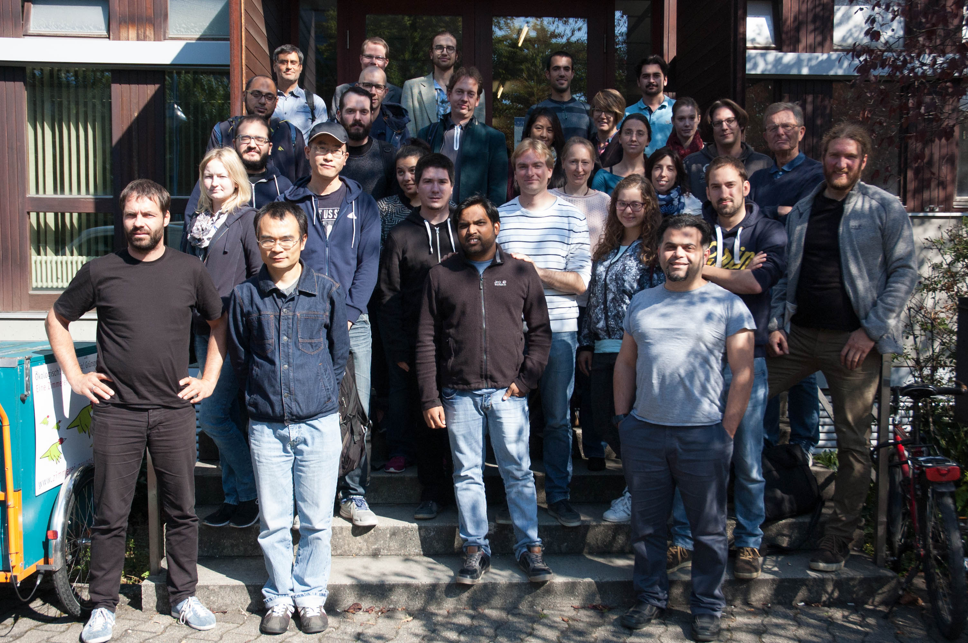






de.NBI − German Network for Bioinformatics Infrastructure
RNA Bioinformatics Center
University of Freiburg
Chair of Prof. Rolf Backofen
RBC
Rolf Backofen, Bérénice Batut, Anika Erxleben, Torsten Houwaart
RNA Bioinformatics Center, University of Freiburg, Germany
Description of RBC Freiburg project
Progress report
Training and education
Organisation of
6 training courses to teach users common HTS techniques, tool development, and Galaxy implementation
Contribution fests to make software more readily available
Migration of our training material and analysis workflow documentation to online repositories for easier collaboration
Ongoing curation and development of training material for newer versions of tools and new emerging techniques requested by users
Active participation in the BioStars forum to answer user questions
Services
Ongoing evaluation of new analysis techniques, methods and software for RNA-RNA and RNA-protein interactions
Development and maintenance of standard analysis pipelines and definition of SOPs
Close cooperation and knowledge exchange with ELIXIR
de.NBI services
de.NBI training and education
The Freiburg Galaxy Server
(http://galaxy.uni-freiburg.de) enables scientists to perform accessible, reproducible and transparent research of biomedical data.
As part of the de.NBI cloud, the Freiburg Galaxy server will be available for all German research facilities in the beginning of 2017.
The RBC Freiburg offers biannual full-day hands-on Galaxy training weeks on HTS data analysis: >220 participants in the last 3 years.
We also offered Galaxy developer workshops in cooperation with ELIXIR and we organised several contribution fests.
The RBC Freiburg is actively involved in making software user-accessible. Tools relevant for HTS data analysis, RNA-protein interaction analysis (e.g. CLIP experiments), RNA-RNA interaction analysis are made available through distribution channels such as BioConda.
Freiburg Galaxy HTS data analysis workshops February (left) and September 2016 (right)
2016 past and planned events
19th – 20th Jan | ELIXIR EDAM codefest | Freiburg
22nd – 26th Feb | Galaxy HTS data analysis workshop | Freiburg
07th – 08th Mar | RAD-Seq tools and workflows codefest | Online
04th Apr | Conda codefest | Online
06th – 07th Apr | Galaxy DevOps workshop | Heidelberg
27th – 29th Apr | HPC workshop | Oslo, Norway
25th – 29th Jun | Galaxy Community Conference workshop | Indiana
27th Jul | RBC Kick-Off meeting | Freiburg
19th – 23rd Sep | Galaxy HTS data analysis workshop | Freiburg
27th – 28th Sep | GalaxyP codefest | Online
06th – 07th Oct | Galaxy training material codefest | Online
20th – 21st Oct | Swiss German Galaxy workshop | Freiburg
24th – 26th Oct | NETTAB hackathon | Rom, Italy
02nd – 03rd Nov | BioConda codefest | Online
30th Nov – 01st Dec | Galaxy Docker workshop | Barcelona, Spain
01st – 02nd Dec | FAIRDOM/de.NBI Foundry workshop | Frankfurt
15th – 16th Dec | Galaxy RNA-seq data analysis workshop | Freiburg
2017 planned events
09th – 10th Jan | Galaxy QIIME codefest | Online
16th – 19th Jan | European Galaxy developer workshop | Strasbourg, France
26th – 27th Jan | Galaxy RNA Seq & admin workshop | Mainz
13th – 17th Feb | Galaxy HTS data analysis workshop | Freiburg
The RNA workbench (http://rna.informatik.uni-freiburg.de) is a server for a series of RNA research tools:
Sequence-structure alignments: LocARNA, CARNA, MARNA
Clustering: ExpaRNA
Interaction prediction: IntaRNA, CopraRNA
Homolog identification: GLASSgo
Sequence design: AntaRNA, INFORNA, SECISDesign
CRISPR repeat analyses: CRISPRmap
Analysis frameworks for specific tasks are made available as Docker images. They incorporate a Galaxy web server with seamlessly included tools, SOP analysis pipelines, training material, a Galaxy interactive tour, and help pages.
Publications
Tools and data services registry: a community effort to document bioinformatics resources. 2015.
doi: 10.1093/nar/gkv1116
The Galaxy platform for accessible, reproducible and collaborative biomedical analyses: 2016 update. 2016.
doi: 10.1093/nar/gkw343
Enhancing pre-defined workflows with ad hoc analytics using Galaxy, Docker and Jupyter. 2016.
doi: 10.1101/075457
Global RNA recognition patterns of post-transcriptional regulators Hfq and CsrA revealed by UV crosslinking in vivo. 2016
doi: 10.15252/embj.201593360
RC3H1 post-transcriptionally regulates A20 mRNA and modulates the activity of the IKK/NF-kappaB pathway. 2016
doi:10.1038/ncomms8367
Hands-on training material for self-study available:
http://bgruening.github.io/training-material
Förderkennzeichen Nr 031A538A
http://www.denbi.de

